Slide 1
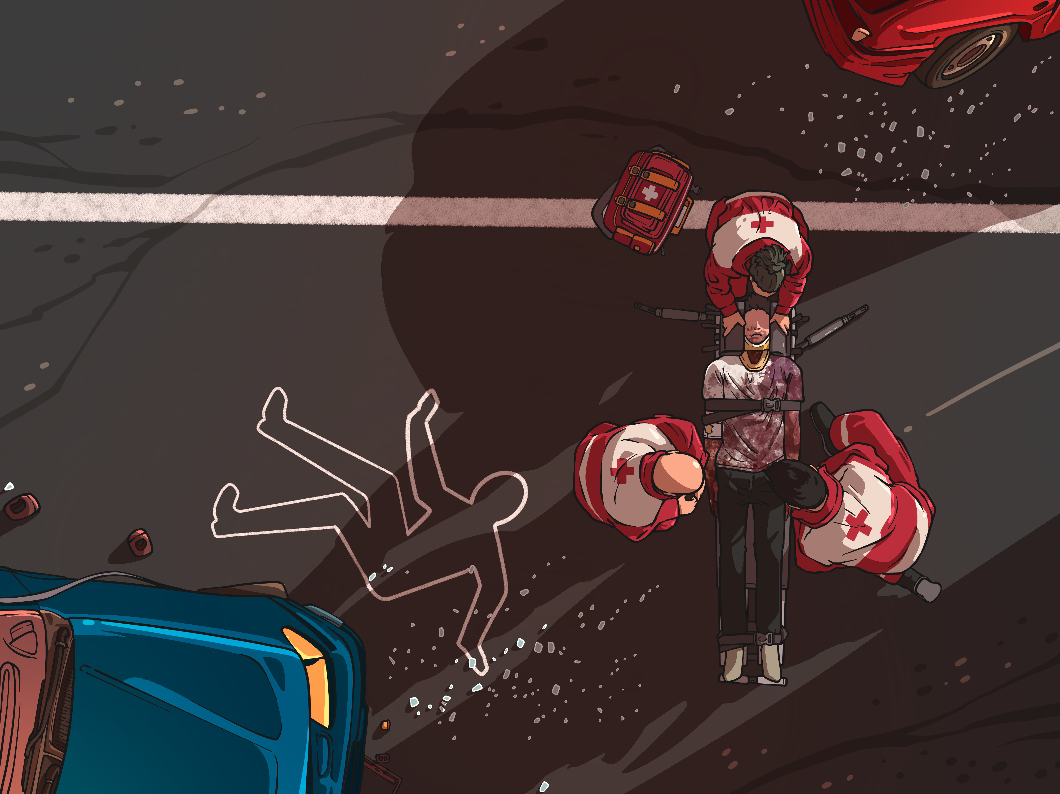


Chicago Traffic Crashes Analysis
Presented by Group - 7
COPYRIGHT © 2021 ALL RIGHTS RESERVED
Source: data.cityofchicago.org

Slide 2



Project Description
The project involves analyzing crash data from the Chicago Police Department's electronic reporting system to identify patterns and factors contributing to road accidents in the city. The dataset covers reportable crashes on city streets and includes information such as street conditions, weather, and speed limits. The goal is to provide insights to improve road safety in Chicago.
SCOPE
This project involves analyzing crash reports from the Chicago PD to identify patterns and factors contributing to traffic incidents in the area. The model we created used 2020 data which, after cleaning, contained 20,000+ rows of data. After cleaning the data the rows, columns dropped from (~70,000, 49) to (~20,000, 24)
The project involves analyzing crash data from the Chicago Police Department's electronic reporting system to identify patterns and factors contributing to road accidents in the city. The dataset covers reportable crashes on city streets and includes information such as street conditions, weather, and speed limits. The goal is to provide insights to improve road safety in Chicago.
The project involves analyzing crash data from the Chicago Police Department's electronic reporting system to identify patterns and factors contributing to road accidents in the city. The dataset covers reportable crashes on city streets and includes information such as street conditions, weather, and speed limits. The goal is to provide insights to improve road safety in Chicago.

Slide 3
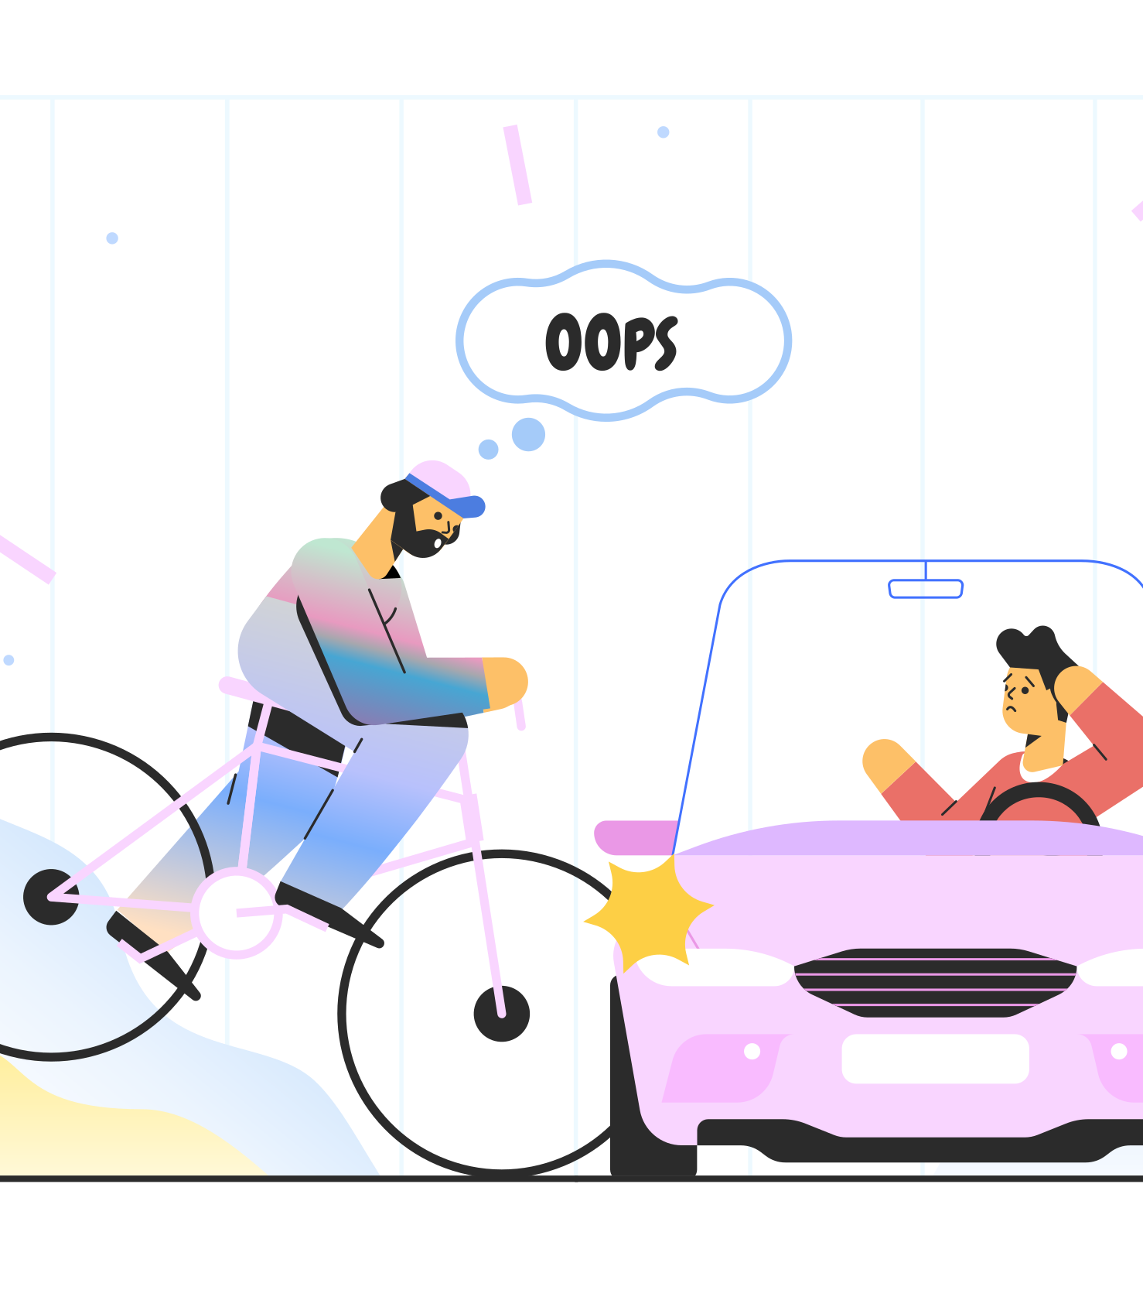

Research Question
The insurance companies are losing millions of dollars well over $3B annually due to lack robust predictive tool, now we helping insurance companies by using over model to predict the likelihood of damages in crashes.
Can we identify hotspots or high-risk areas where crashes are most likely to occur, based on historical crash data and other factors such as traffic volume and road design?
Can we predict the likelihood of a hit-and-run or other type of non-fatal crash being solved based on available data (e.g. time of day, location, etc.)?
Which factors contribute the most to the number of injuries in a crash?

Slide 4
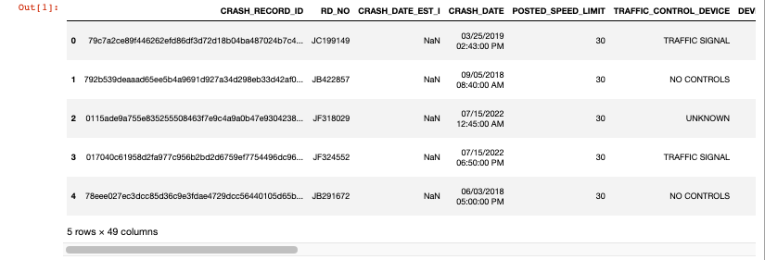

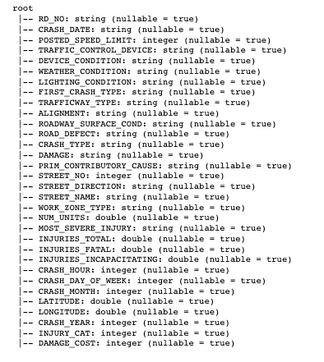


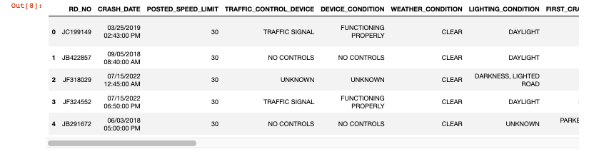
Extract TRANSFORM load

Slide 5

TABLEAU DEMO

Slide 6
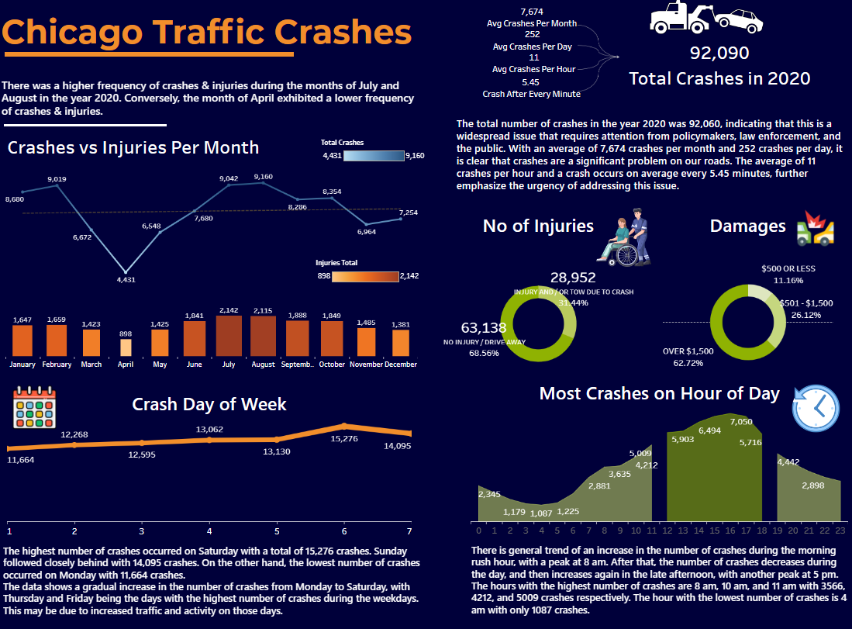

Slide 7
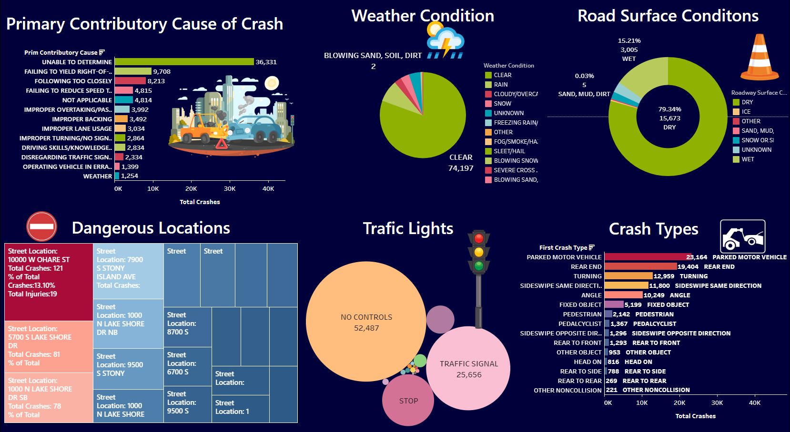

Slide 8
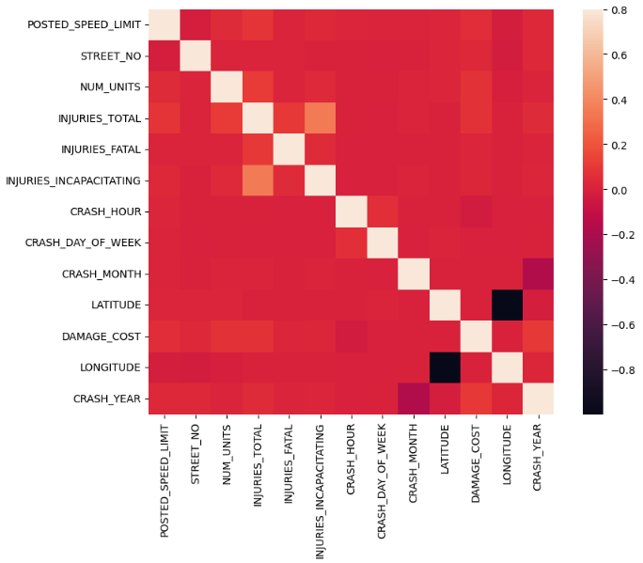
correlation heatmap
This heatmap outlines the variables varying levels of correlation between each other
The most important variables according to this heatmap are
- Injuries Total
- Injuries Incapacitating

Slide 9
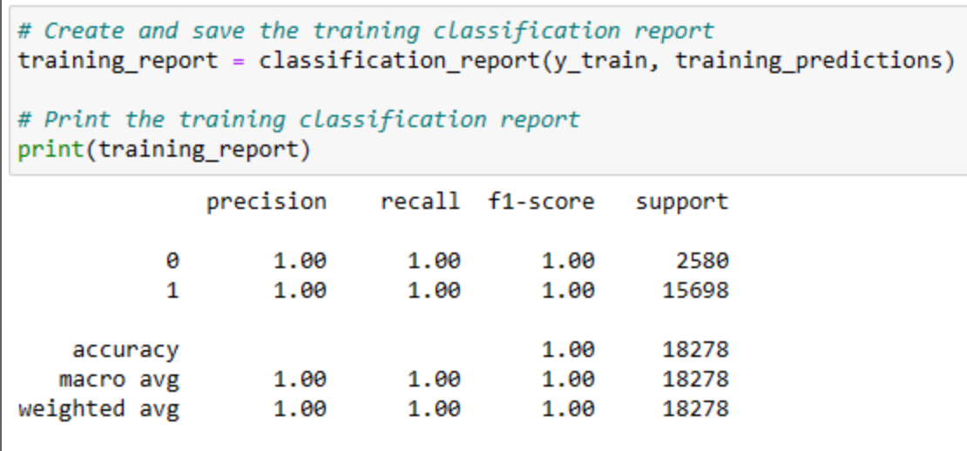
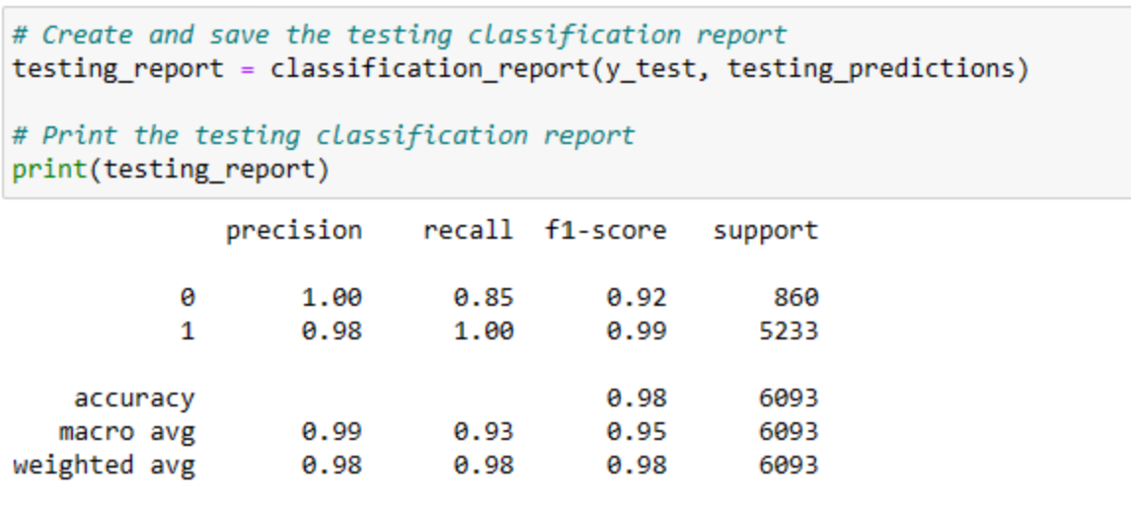
training Report
Machine learning logistic Regression Model
Target variable: INJURIES_TOTAL
- Prediction of the high-risk streets vs the low-risk area.
- Aims to predict the highest risk area.
- Accuracy of model: 98%
- High Bias, appears to be underfitting the data which provides good results but difficult to be confident in
Testing Report

Slide 10
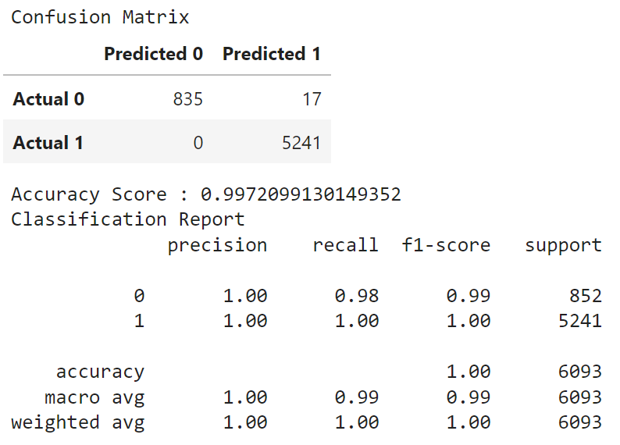
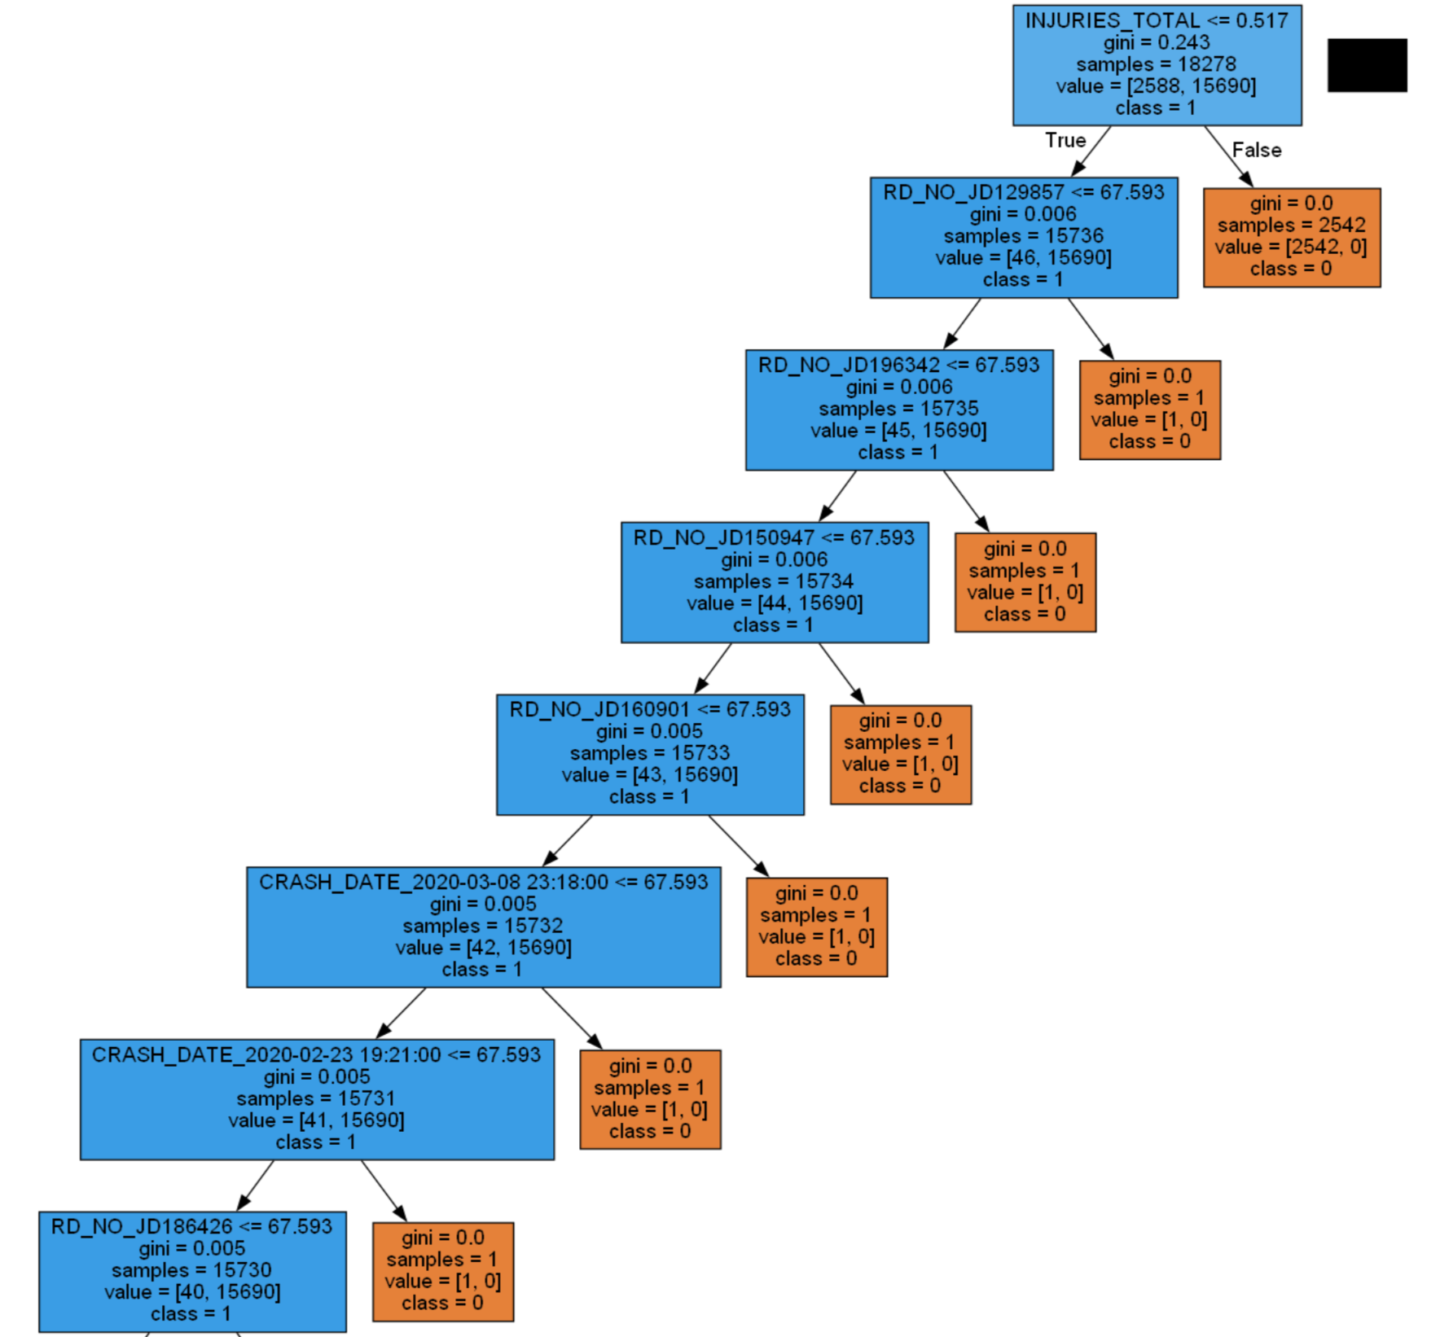
Machine learning Decision tree Model
Target variable: INJURIES_TOTAL
Accuracy of 99.72% based on test data

Slide 11
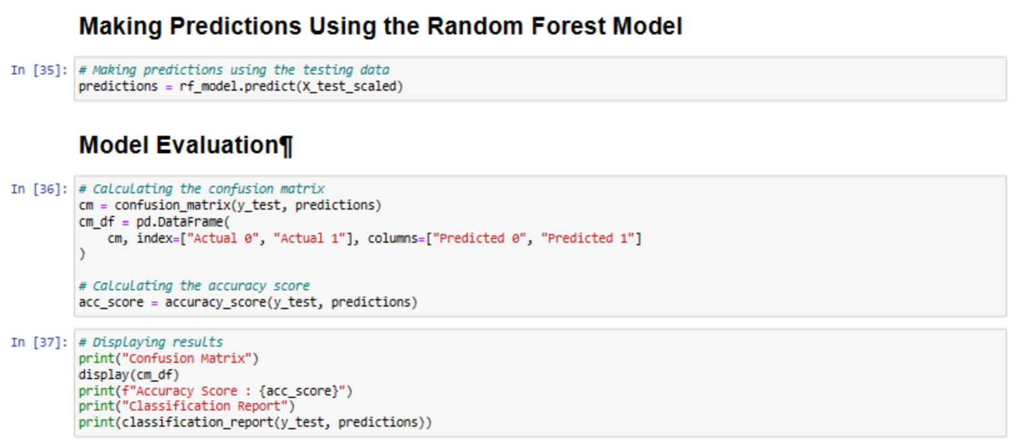
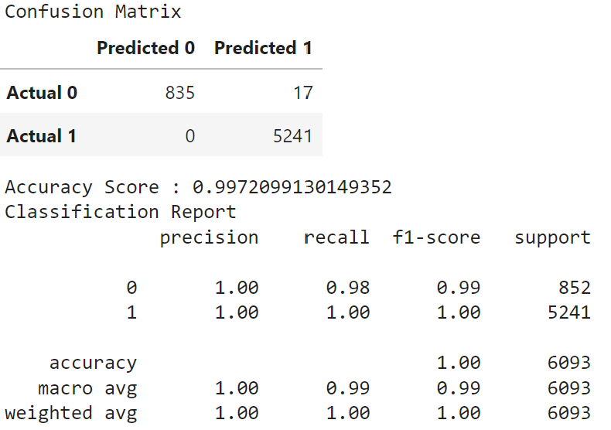
Machine learning random forest Model
Target variable: INJURIES_TOTAL
- Accuracy of model: 99.7%
- Accuracy of 99.72% based on test data

Slide 12
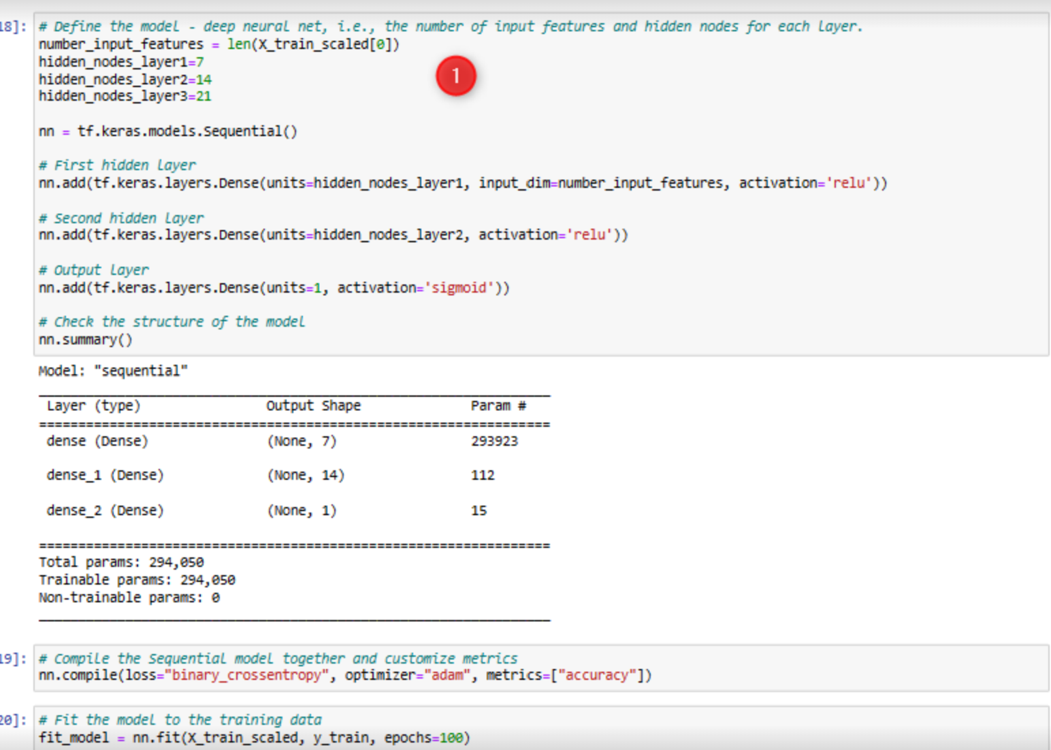
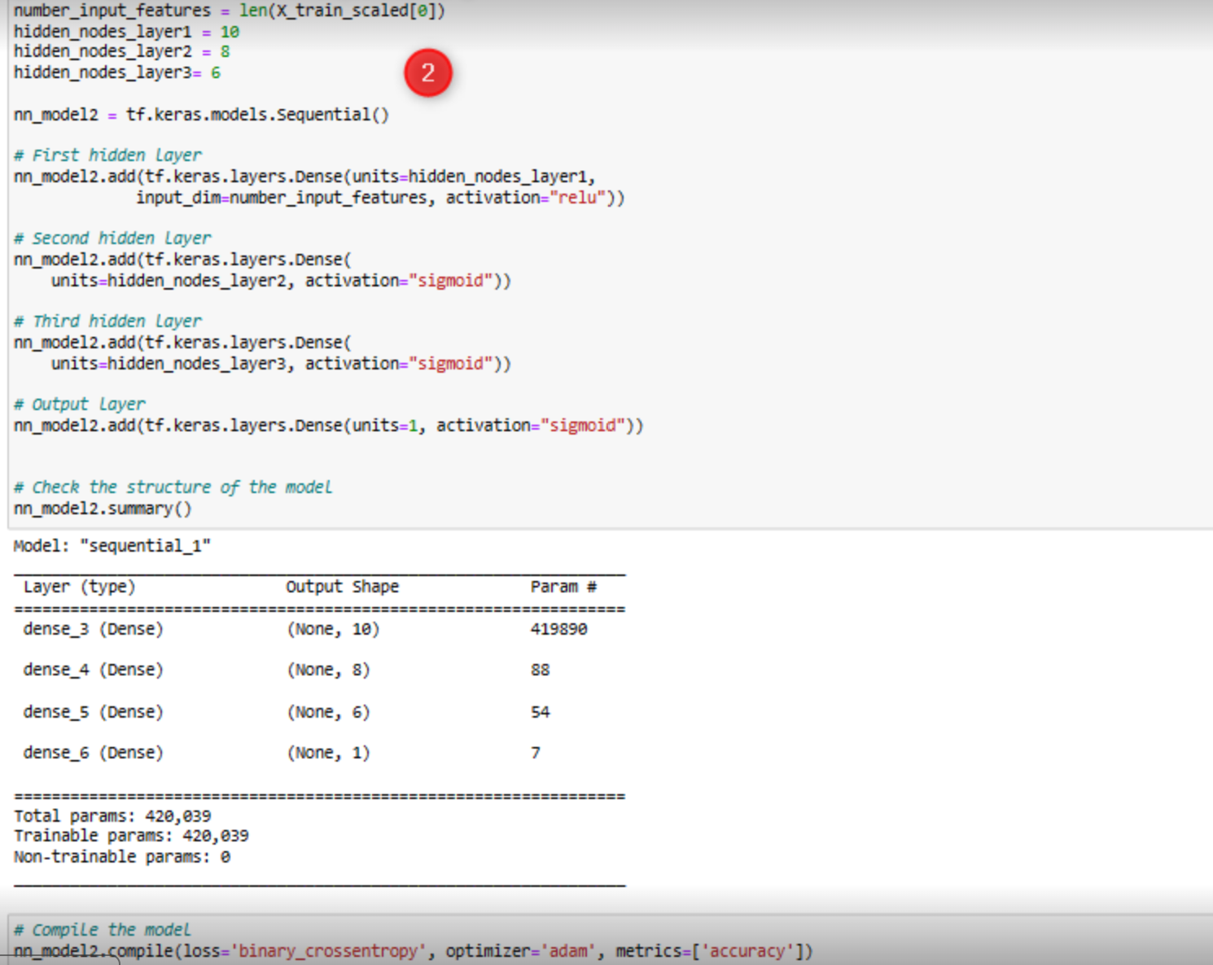
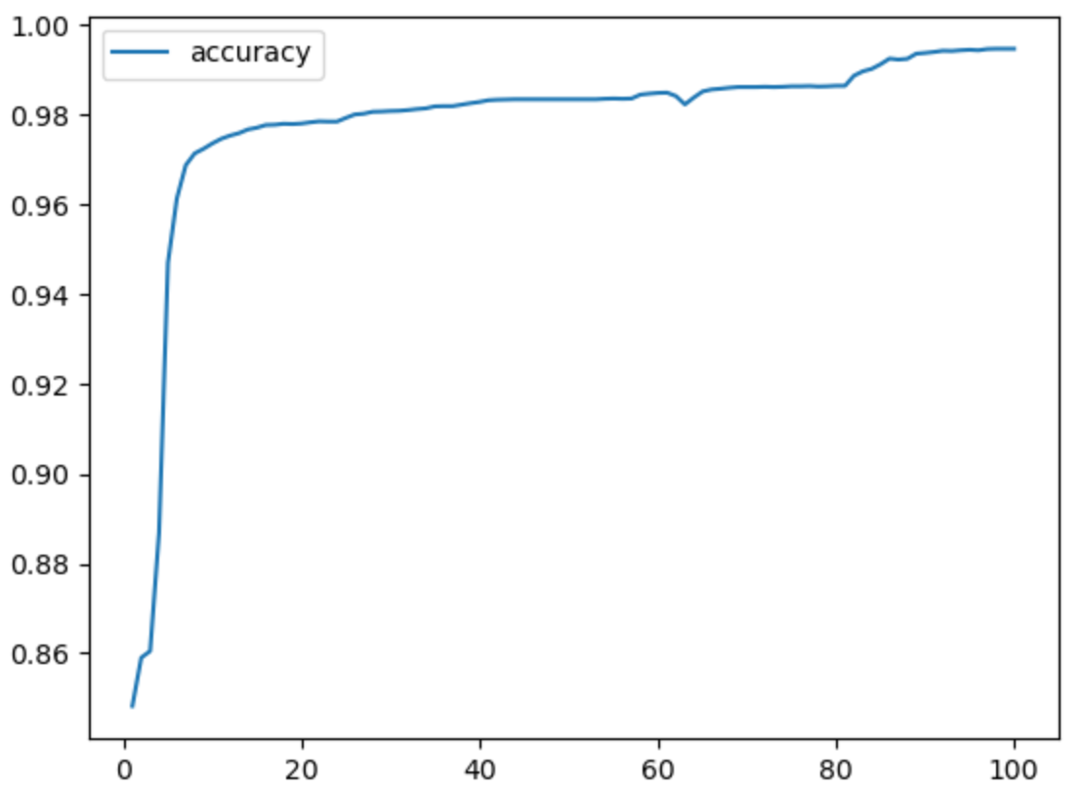
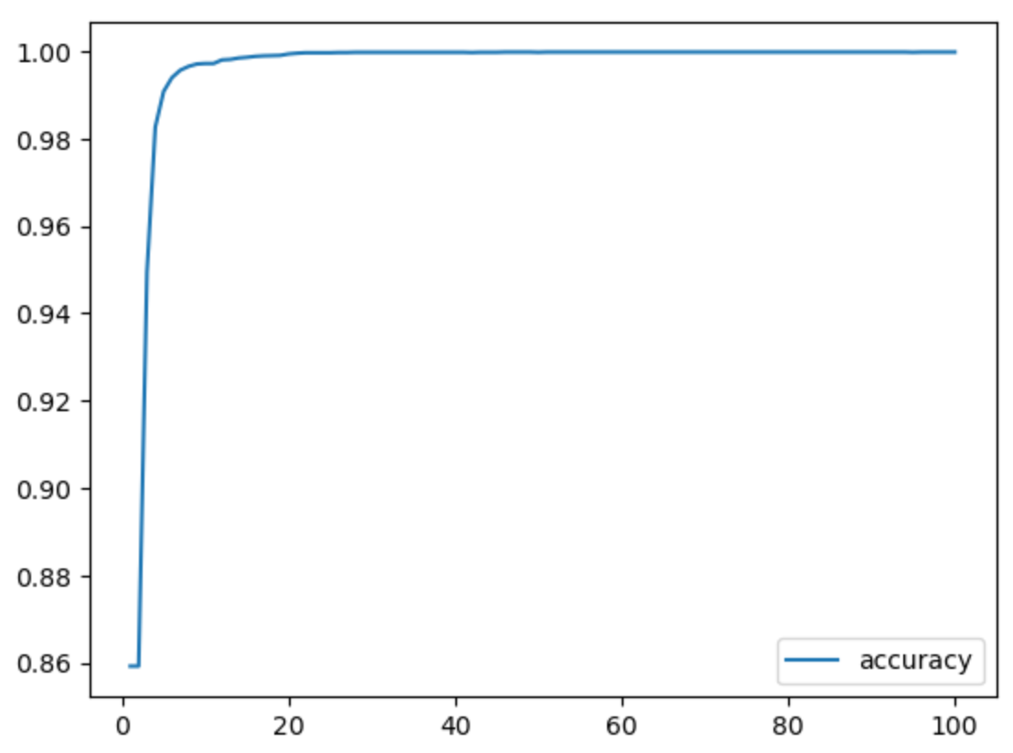
trail 1
trail 2
Machine learning
DEEP LEARNING model and optimization
Trial 1
Total parameters: 294,050
Model Accuracy: 87.8%
191/191 - 1s - loss: 4.3641 –
accuracy: 0.8776 - 733ms/epoch - 4ms/step
Loss: 4.364131450653076, Accuracy: 0.8775644302368164
191/191 - 1s - loss: 0.8260 –
accuracy: 0.9073 - 675ms/epoch - 4ms/step
Loss: 0.8259850740432739, Accuracy: 0.907270610332489
Optimized (Trial 2)
Total parameters: 420,039
Model Accuracy: 90.7%

Slide 13

Limitations
No premium data so it was difficult to specify the true cost of damages caused in each incident.
<500
500-1500
1500+
How to correct..
With additional premium (cost, not data quality) datasets it will be a much more robust model that can more accurately predict damages which will ultimately be more helpful to the insurance company.
As always with more time and funding, the model will continue to perform better

Slide 14

conclusion
Conclusion
Deep Learning Model is the best model to use to predict the high-risk areas of Chicago’s streets to apply to an insurance company’s model to help gauge the right pricing for a user of their services.
Once the classification models are deployed to the insurance industry, the problem of assessing risk and cost of traffic crashes in cities such as Chicago can be ideally reduced to negligible quantities.

Slide 15







MEET OUR EXPERT TEAM
SAMEEN SHAHZAD
SUNDAY AKIYESI
FARMAN SYED
JOHN FRANCAVILLA
Data Analyst
Data Analyst
Data Analyst
Data Analyst
COPYRIGHT © ALL RIGHTS RESERVED

Slide 16
THANK YOU
FROM TEAM - 07
Any questions?

